Slide 1

Install Virtual Network / Test Web Application
AM
Abstract Mash-up
Final Project

Slide 2

Presented by:
AM
Abstract Mash-up
Trisha Solanki
Priyanshu Patel
Mandeep Singh
Deepika Kandol

Slide 3

Introduction
Purpose
Create a network environment of 5 systems on VirtualBox.
The environment consists of 3 servers and 2 clients.
3 Servers: Router, Domain Controller, and Web server
2 Clients: Windows 10 and Windows 8.1
Host a web application on web server and access it from client machines
Test the connectivity of the network and test the web application

Slide 4

Name Convention
Format
Router : SVR-SO-A-1913083
Domain Controller : SVR-DC-A-1913083
Web Server : SVR-WS-A-1913083
Client 1 : Windows10-1913083
Client 2 : Windows8.1-1913083

Slide 5
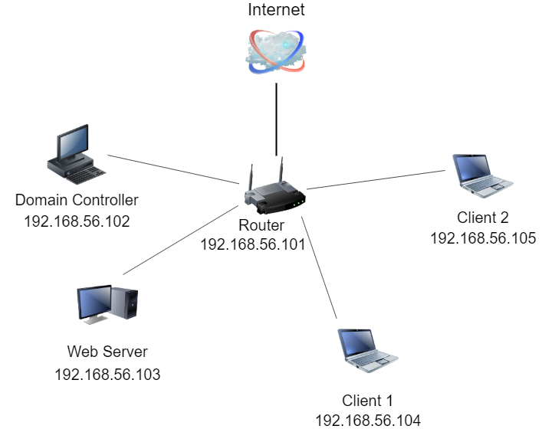
Systems Interaction

Slide 6
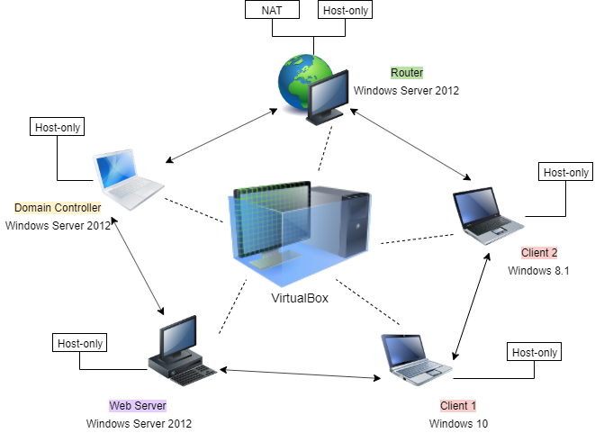
Abstraction

Slide 7
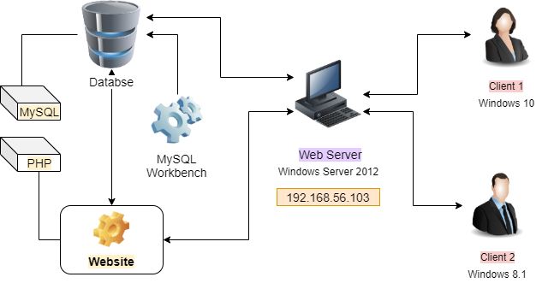
Accessing Website

Slide 8
Steps to follow
Process
Installation
Router – Install Windows Server 2012 on adapters NAT & Host-only
Domain Controller – Install Windows Server 2012 on adapters Host-only
Web Server – Install Windows Server 2012 on adapters Host-only
Client 1 – Install Windows 10 on adapters Host-only
Client 2 – Install Windows 8.1 on adapters Host-only

Slide 9
Steps to follow
Process after Installation
Configuration
Add roles and features
Set IP Addresses and Inbound/Outbound Rules for all systems
Turn on Internet connection for all systems
Check the connectivity with each other and with Internet connection
Host website on webserver

Slide 10
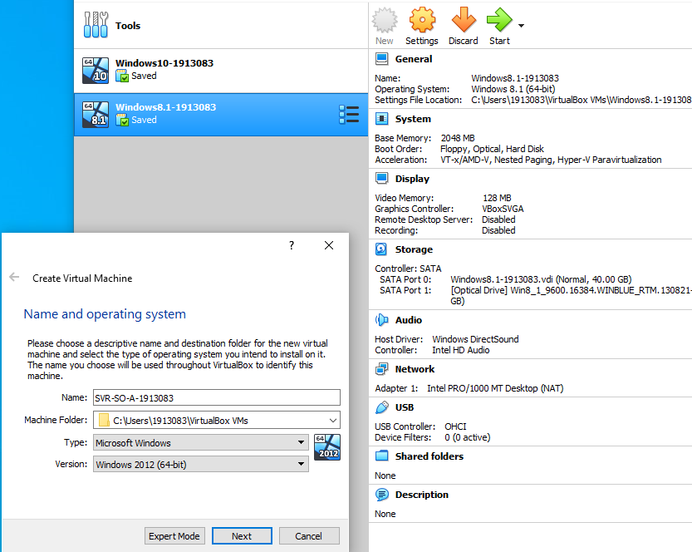
Example
Installing System on virtualBox

Slide 11
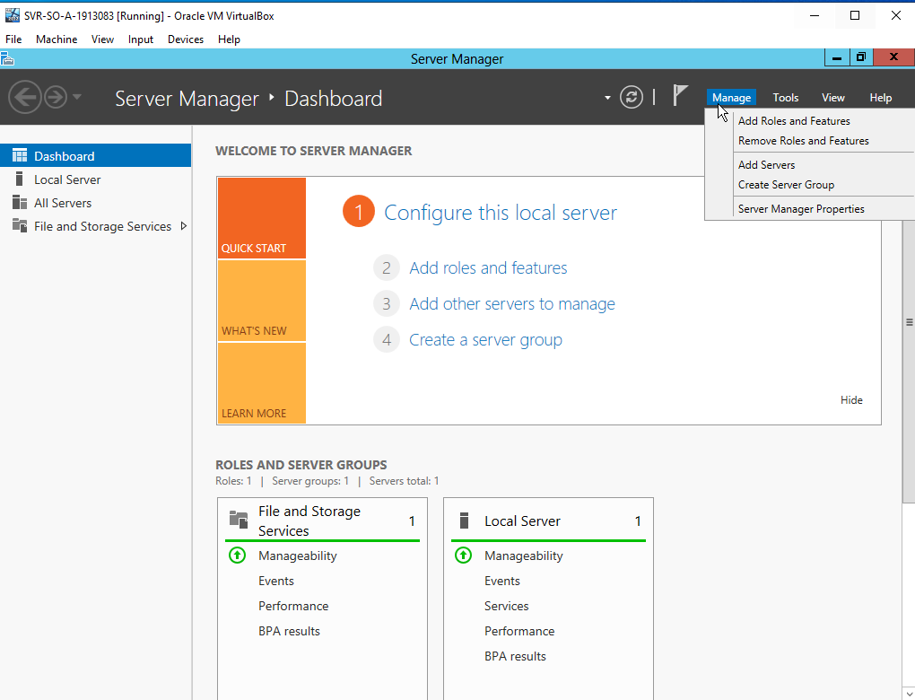
Server Manager
Example of Server Manager Dashboard on all servers

Slide 12
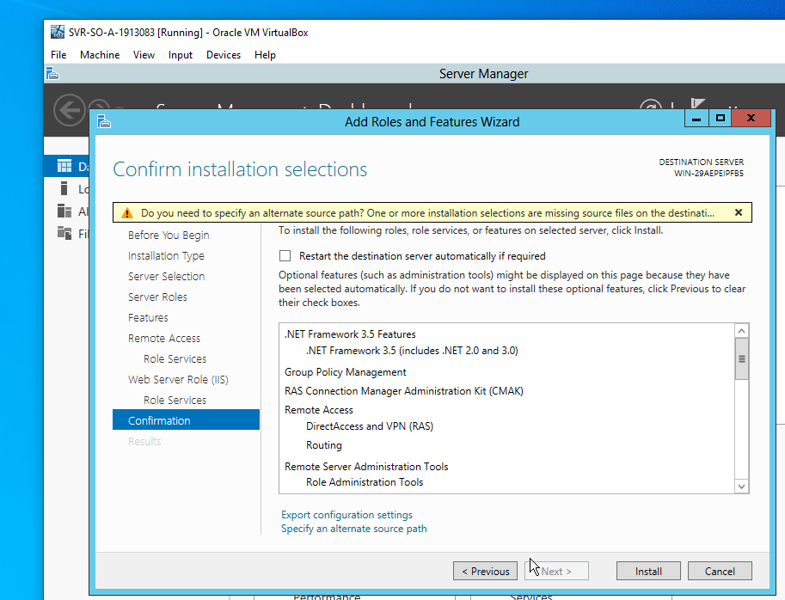
SVR-SO-A
Configuring Router

Slide 13
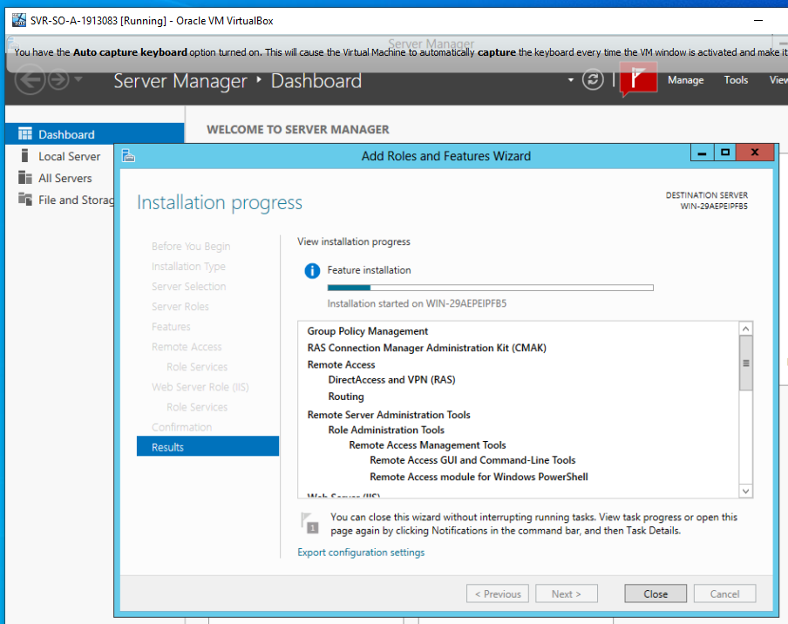
SVR-DC-A
Configuring Domain Controller

Slide 14
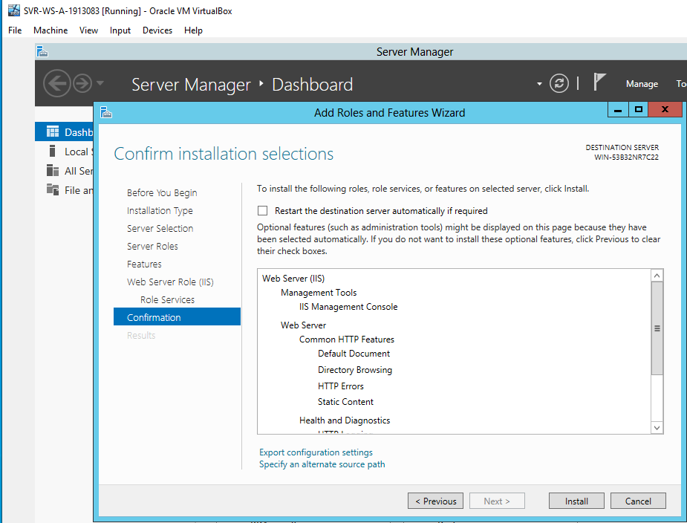
SVR-WS-A
Configuring Web Server

Slide 15
IP Address
System | Given Name | Selected IP Address
Router | SVR-SO-A-1913083 | 192.168.56.101
Domain Controller | SVR-DC-A-1913083 | 192.168.56.102
Web Server | SVR-WS-A-1913083 | 192.168.56.103
Client 1 – Windows 10 | Windows10-1913083 | 192.168.56.104
Client 2 – Windows 8.1 | Windows8.1-1913083 | 192.168.56.105

Slide 16
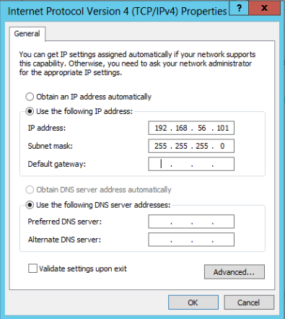
Example
Assigning IP Address

Slide 17
Gateway and DNS
System | Selected IP Address | Default Gateway | DNS Server
Router | 192.168.56.101 | - | -
Domain Controller | 192.168.56.102 | 192.168.56.101 | 192.168.56.102
Web Server | 192.168.56.103 | 192.168.56.101 | 192.168.56.102
Client 1 – Windows 10 | 192.168.56.104 | 192.168.56.101 | 192.168.56.102
Client 2 – Windows 8.1 | 192.168.56.105 | 192.168.56.101 | 192.168.56.102

Slide 18

Inbound/Outbound Rules
Setting Inbound and Outbound rules in all systems to allow these systems to connect with each other in case of firewall or security reasons
Systems | Inbound Rules | Outbound Rules
Router
Domain Controller
Web Server
Client 1 – Windows 10
Client 2 – Windows 8.1

Slide 19
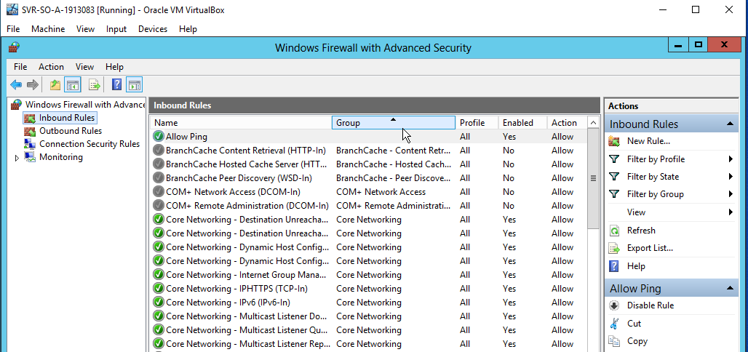
Example
Inbound Rules

Slide 20
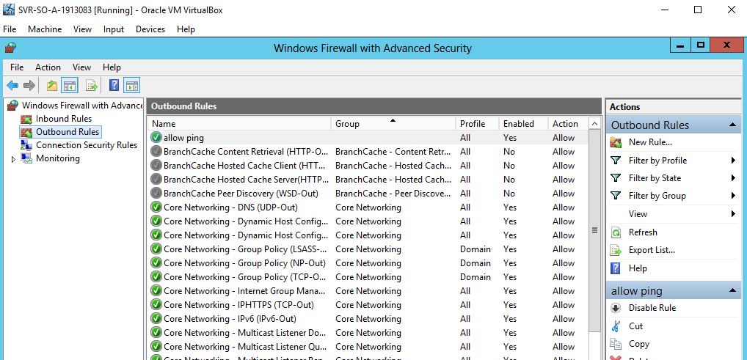
Example
Outbound Rules

Slide 21
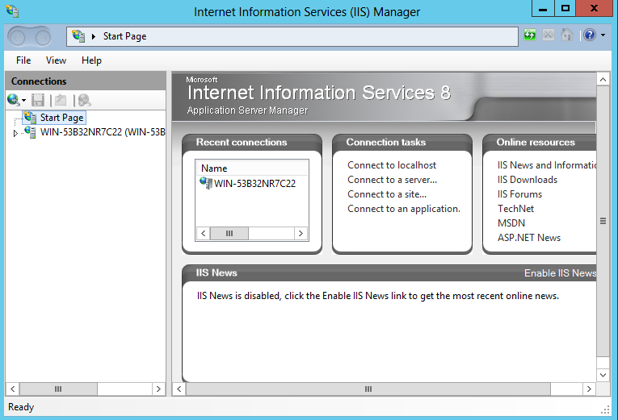
Hosting Website
Host a given website on Web Server

Slide 22
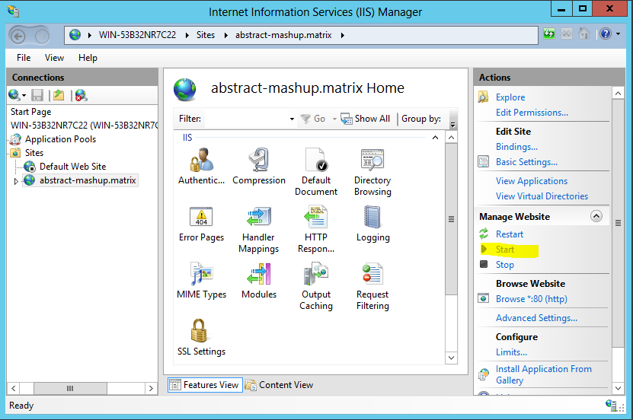
Adding Domain
Domain name : abstract-mashup.matrix

Slide 23
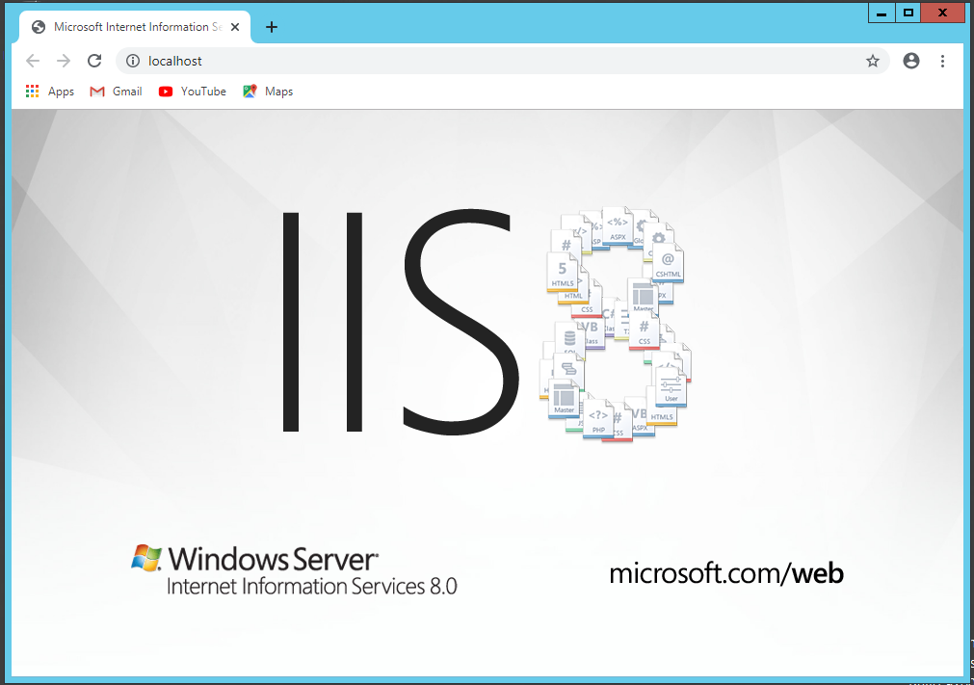
Live Website
After adding domain it should look like this :

Slide 24
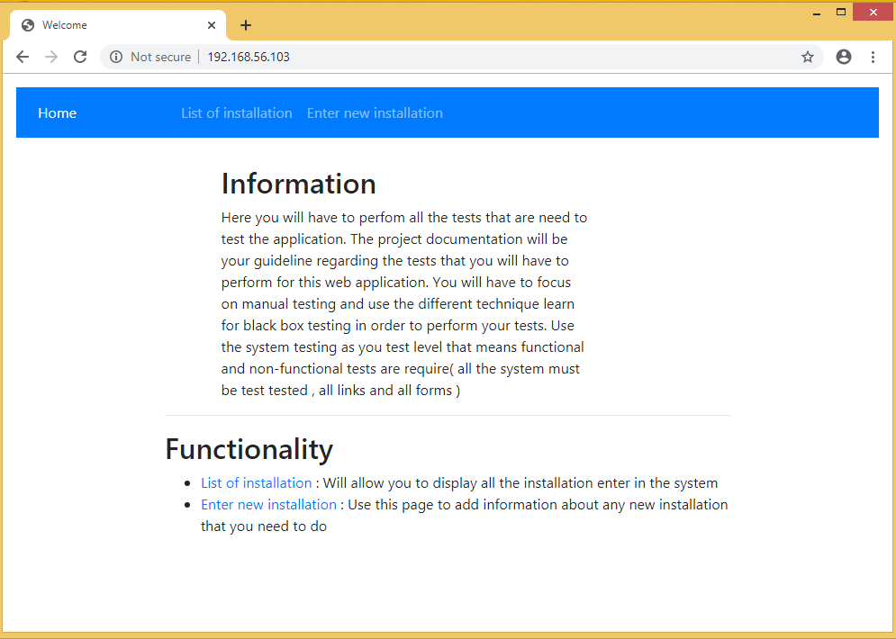
Adding Pages
After adding all the given pages to website it looks like this :

Slide 25
Testing website
Types of testing
Testing
Functional Testing
Non-functional Testing

Slide 26
Functional Testing
Levels of testing
Unit Testing
Integration Testing
System Testing
1.
2.
3.

Slide 27
Non-functional Testing
Efficiency Testing
Speed Testing
Availability Testing

Slide 28
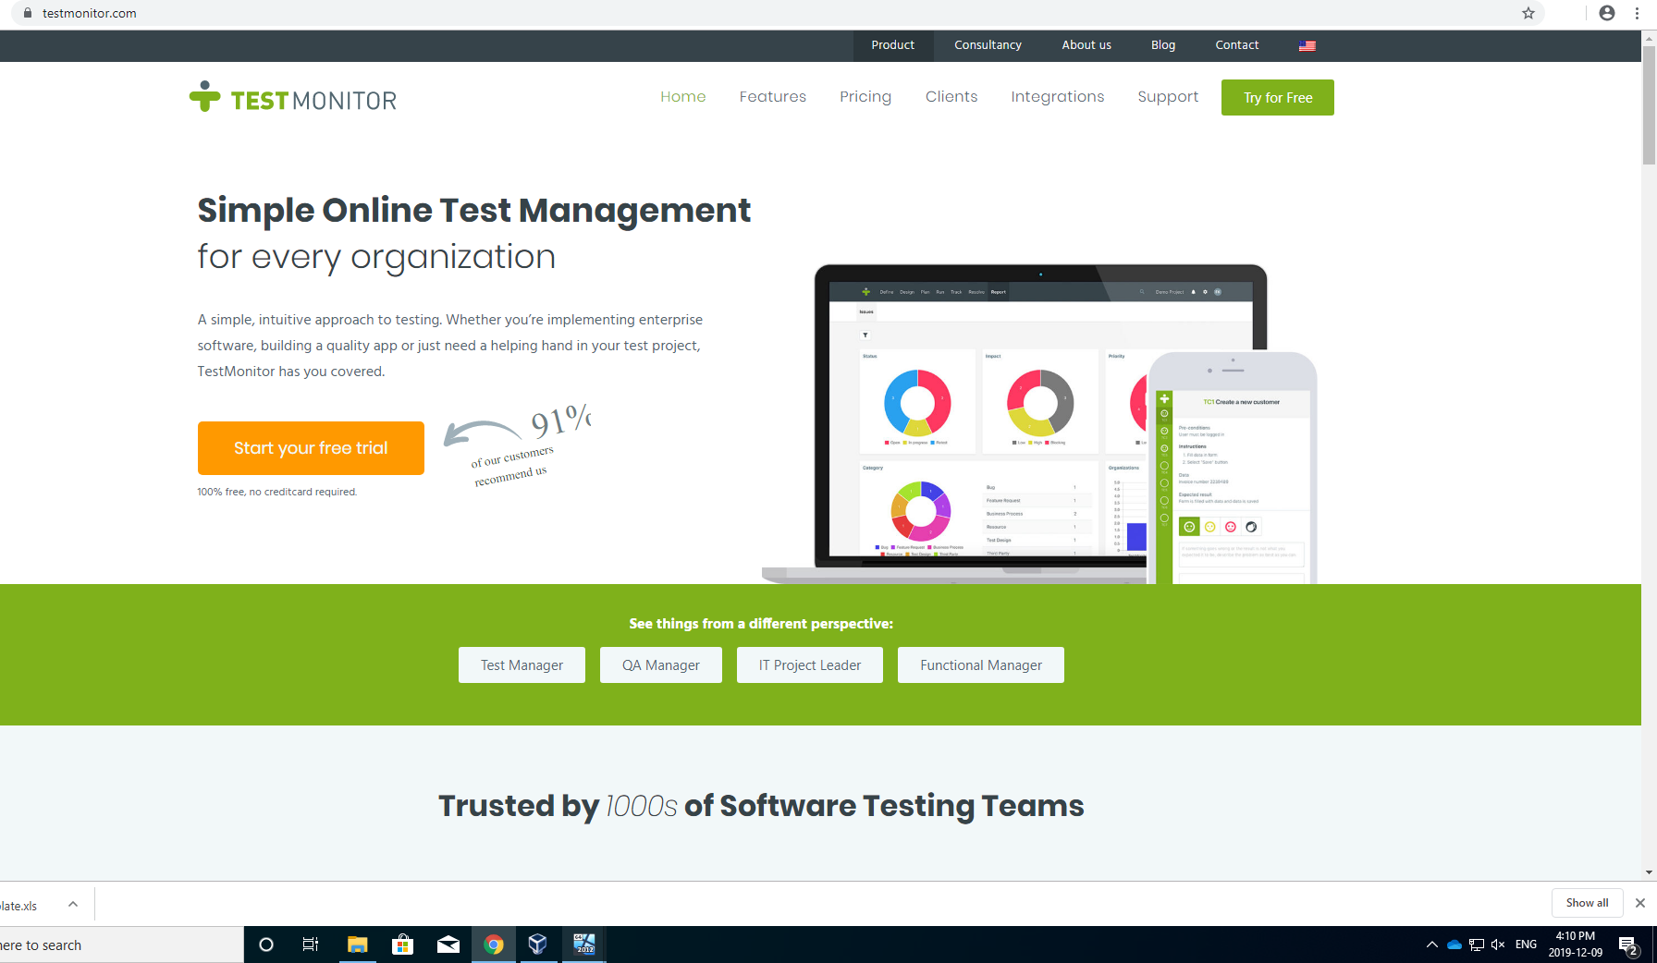
Test Monitor
A testing tool to manage and run test cases

Slide 29
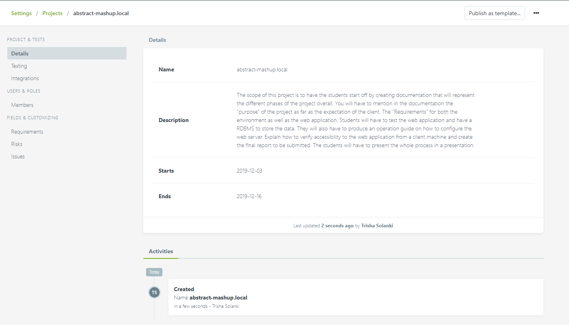
Adding Project

Slide 30
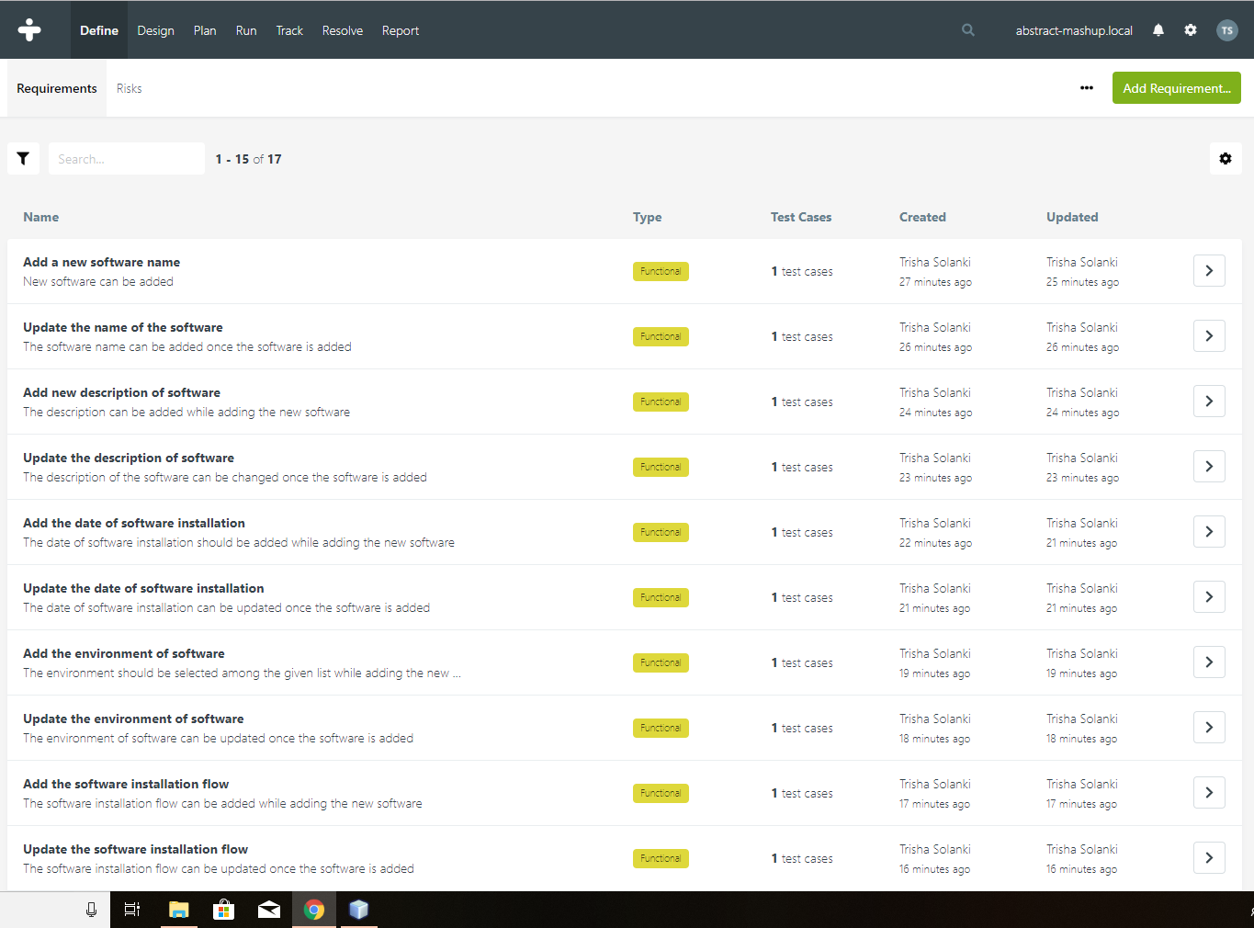
Adding Requirements

Slide 31
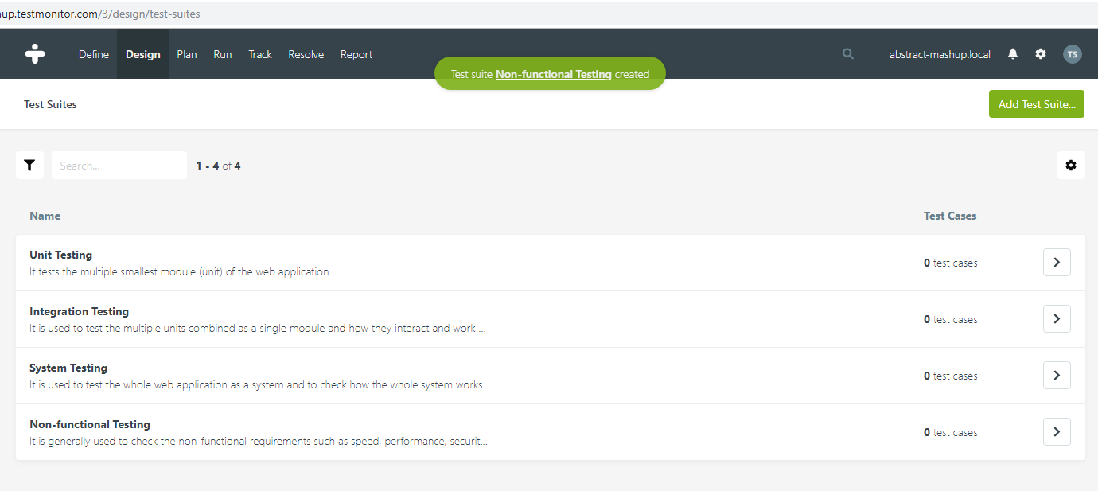
Adding Test Suits

Slide 32
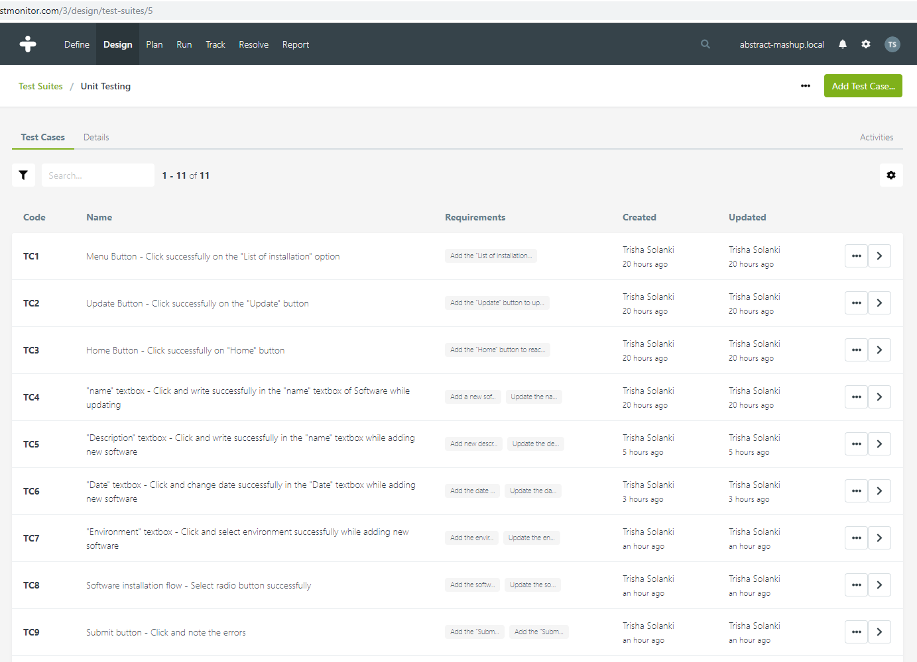
Adding Test Cases

Slide 33
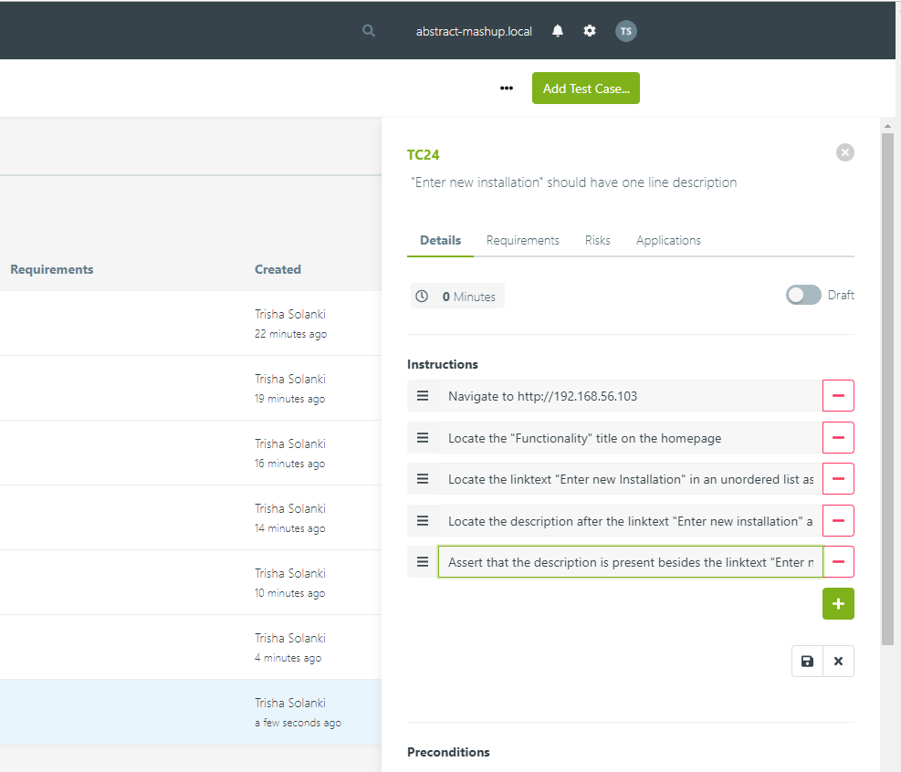
Positive Test Cases

Slide 34
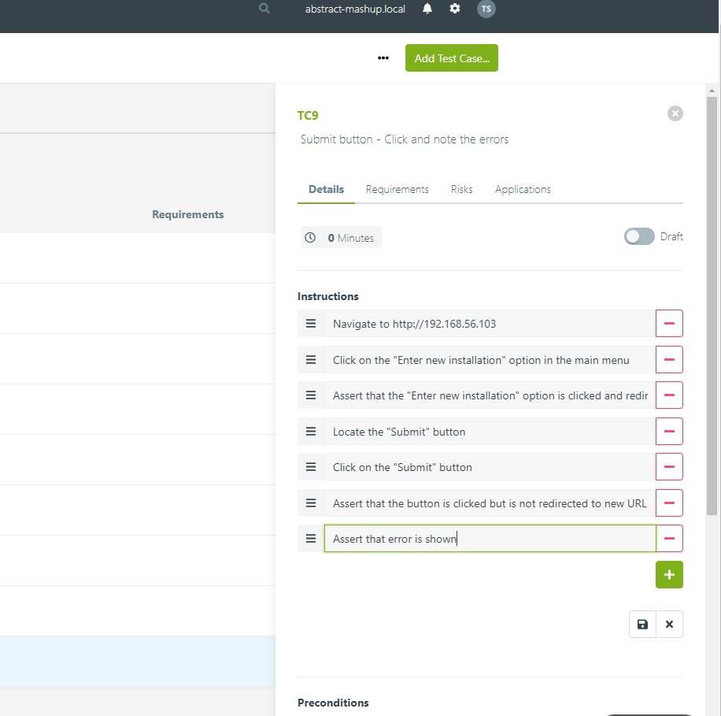
Negative Test Case

Slide 35
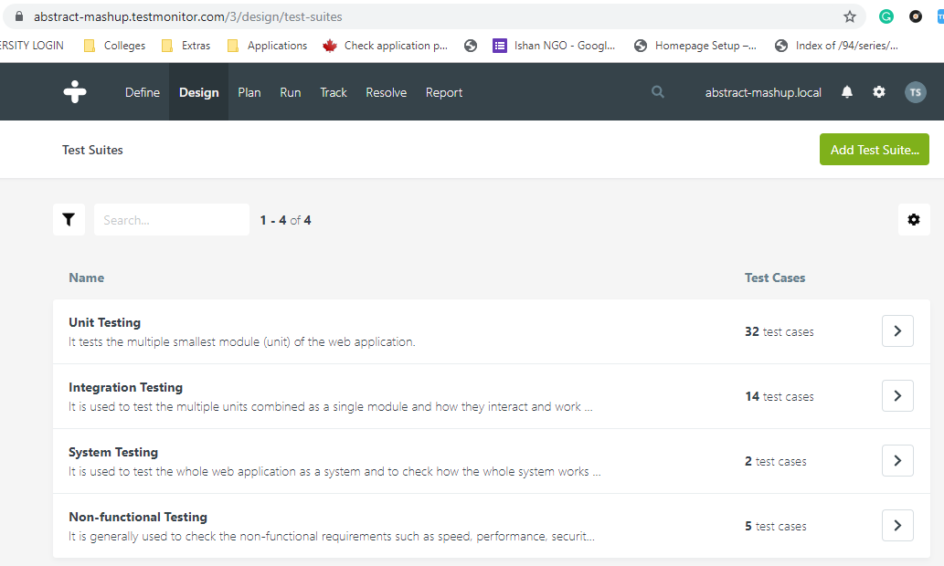
Test Suits
Test suits after adding test cases to the test suits

Slide 36
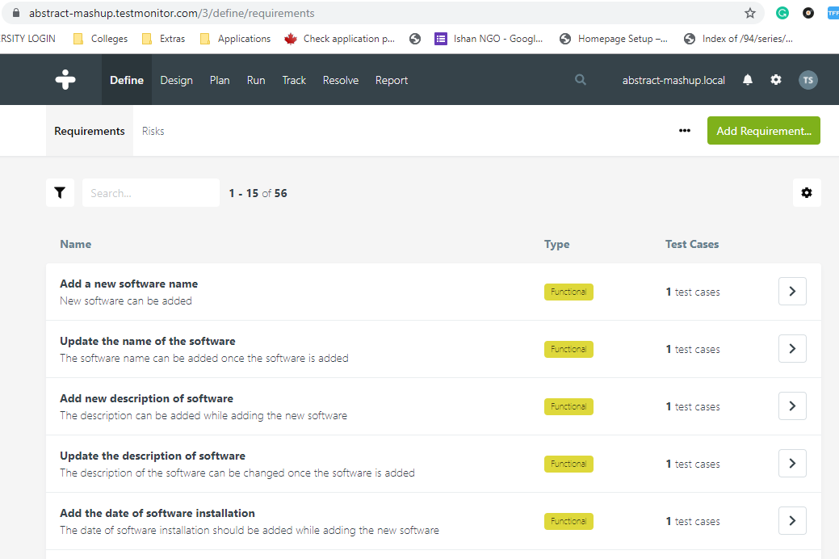
Attaching requirements

Slide 37
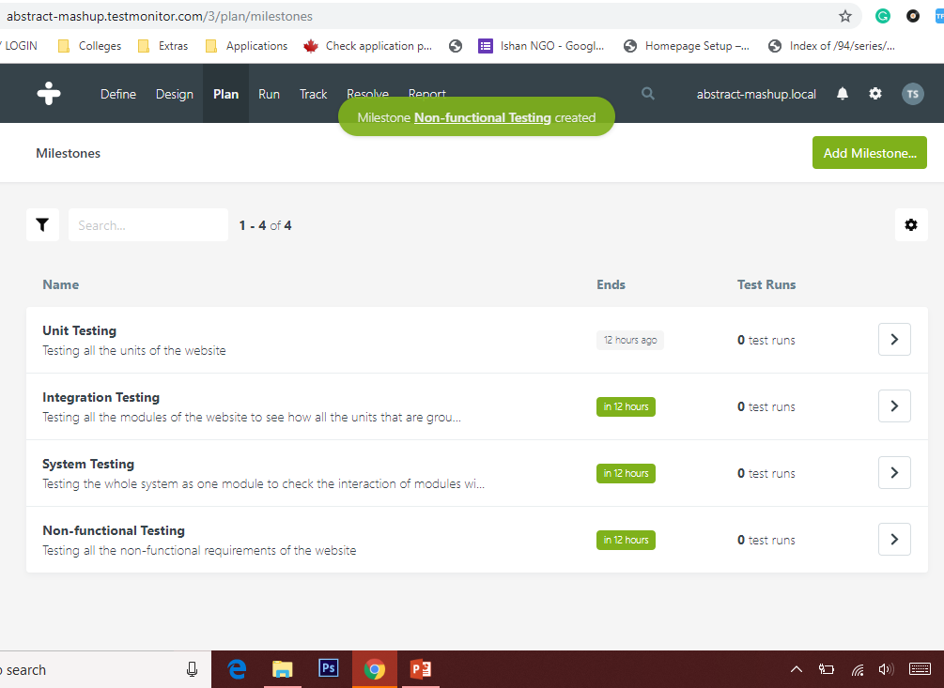
Adding Milestones

Slide 38
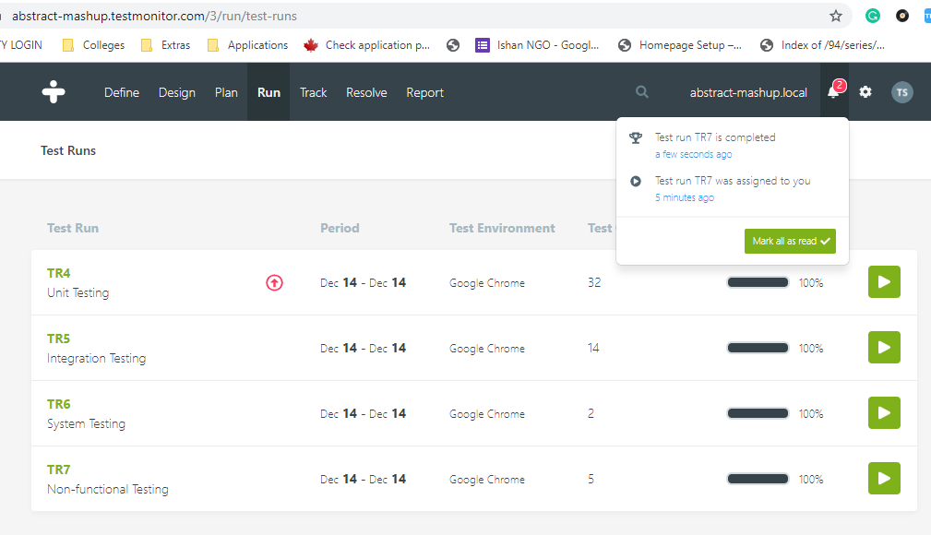
Adding Test Runs

Slide 39
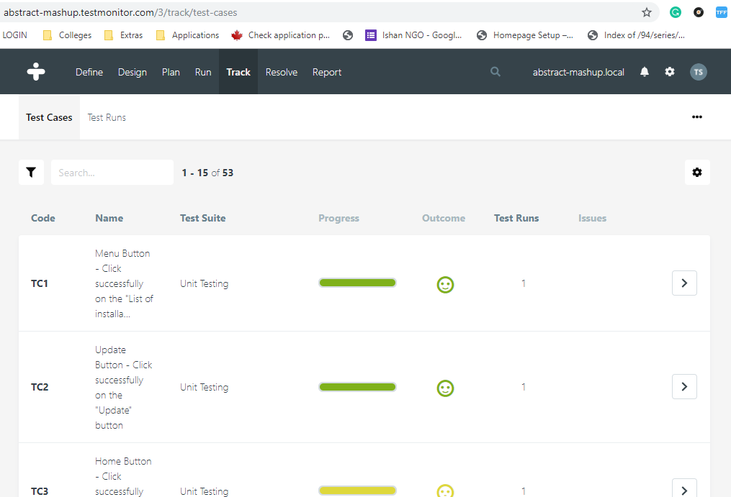
Tracking Test Runs

Slide 40
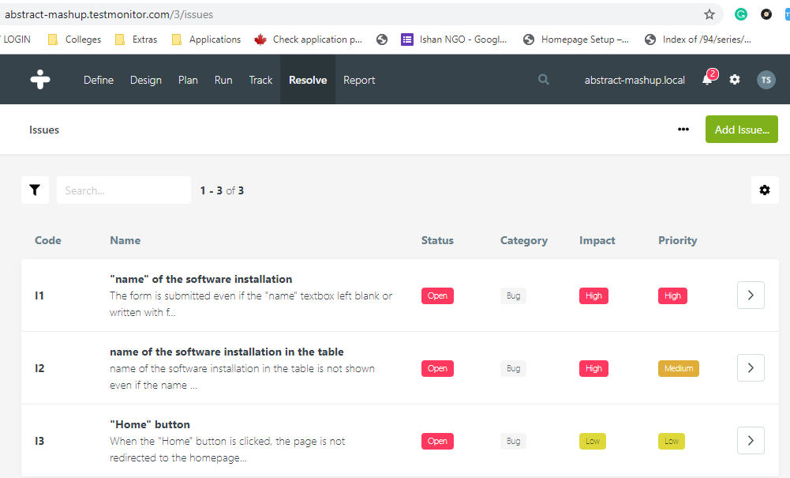
Reporting Issues

Slide 41
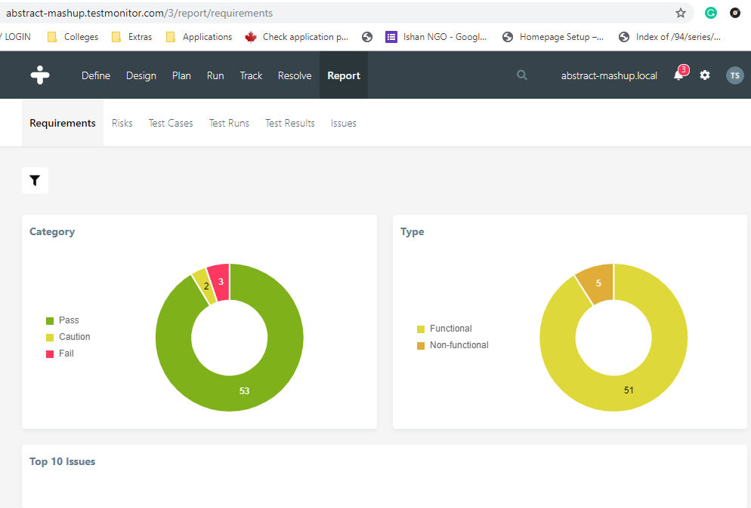
Test Requirements Report

Slide 42
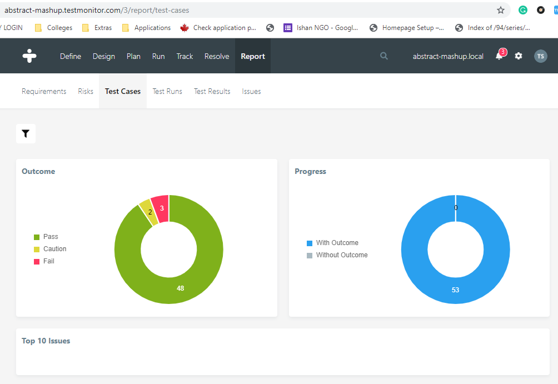
Test Cases Report

Slide 43
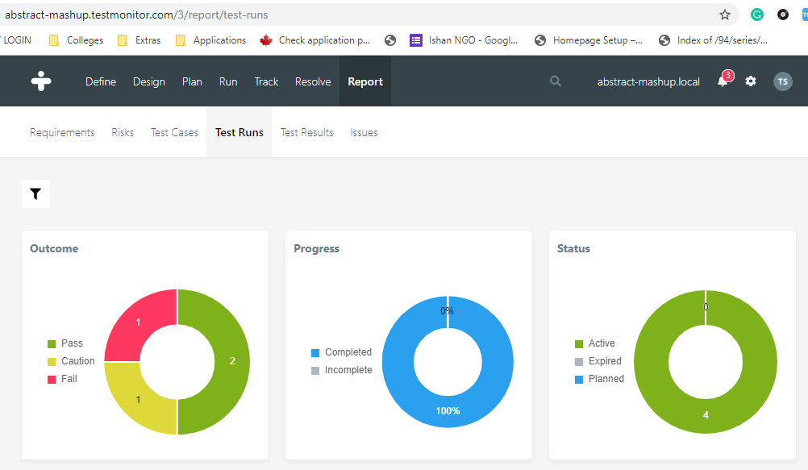
Test Runs Report

Slide 44
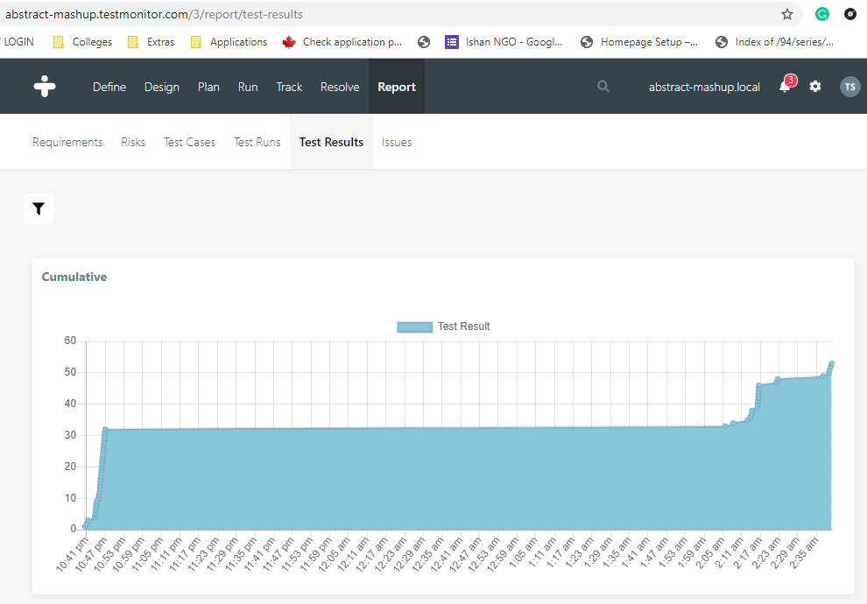
Test Results Report

Slide 45
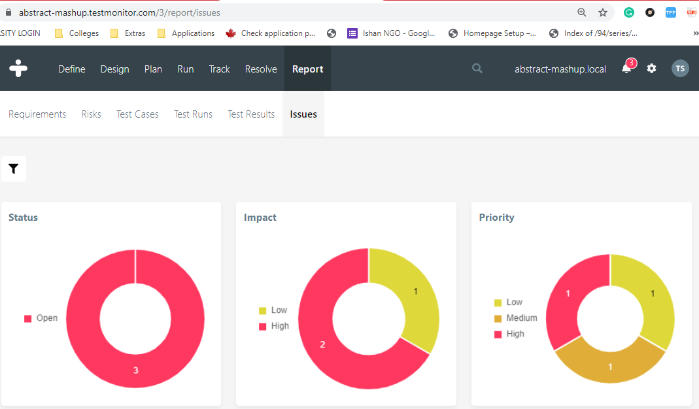
Issues Report

Slide 46
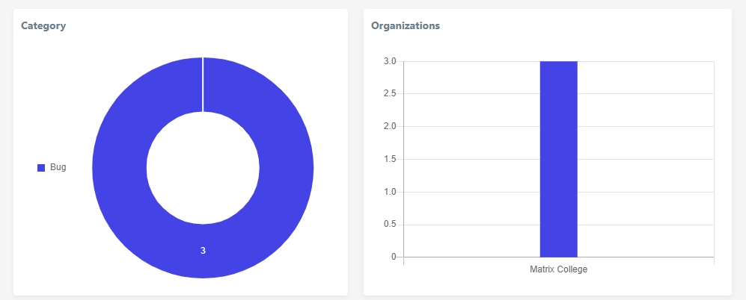
Issues Report

Slide 47
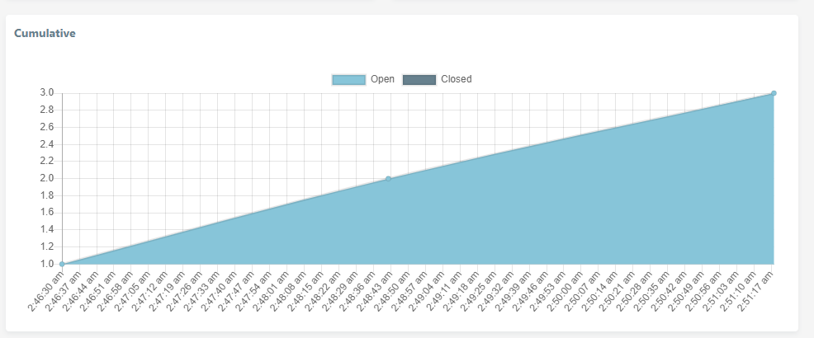
Issues Report

Slide 48
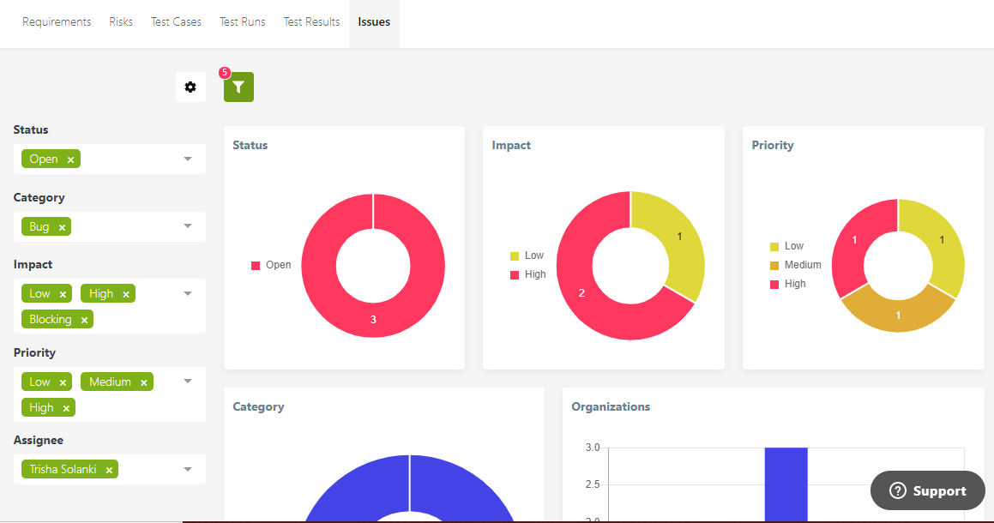
Issues Report with Filters

Slide 49
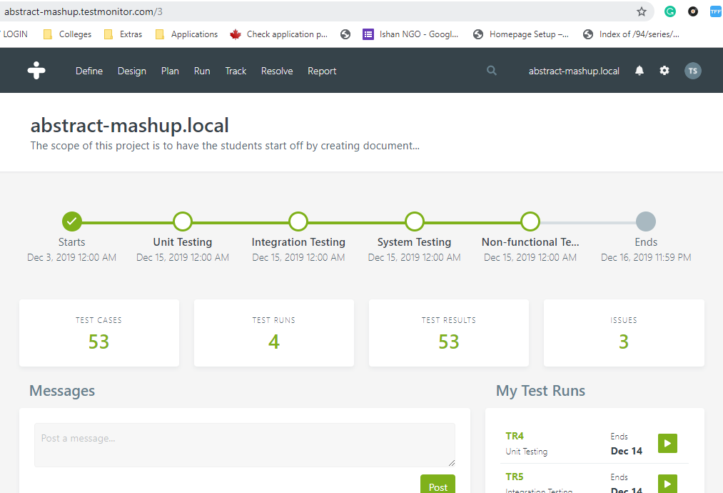
Dashboard after testing

Slide 50
Data Analysis & Data Visualization on Tableau
File created on:
16-12-2019
09:48:55 PM

Slide 51
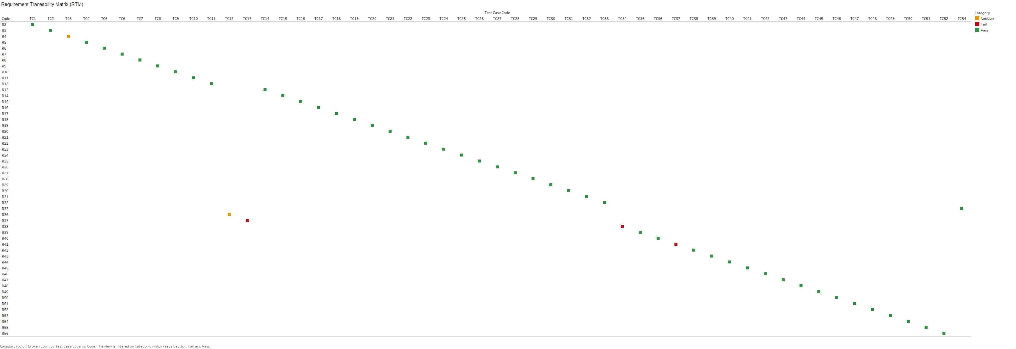
Requirement Traceability Matrix (RTM)

Slide 52
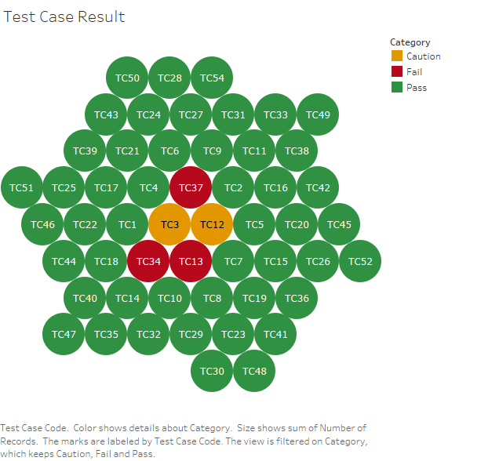

Slide 53
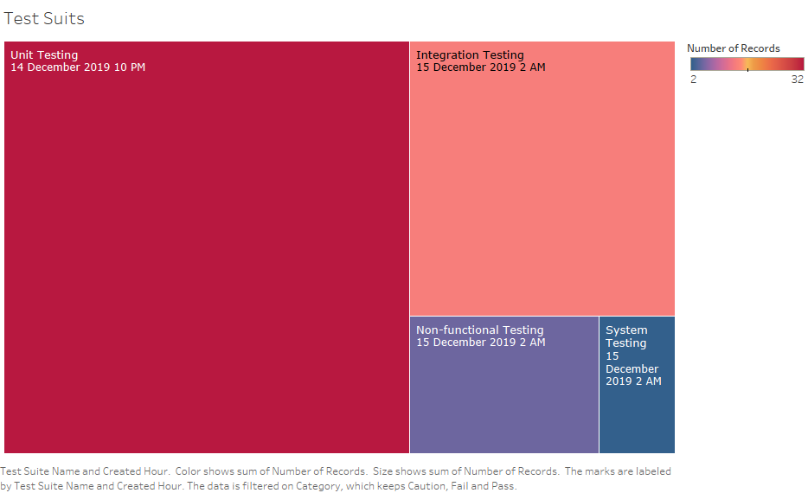

Slide 54
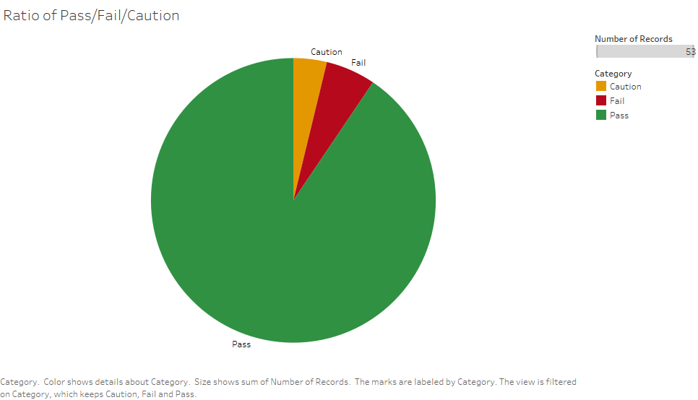

Slide 55
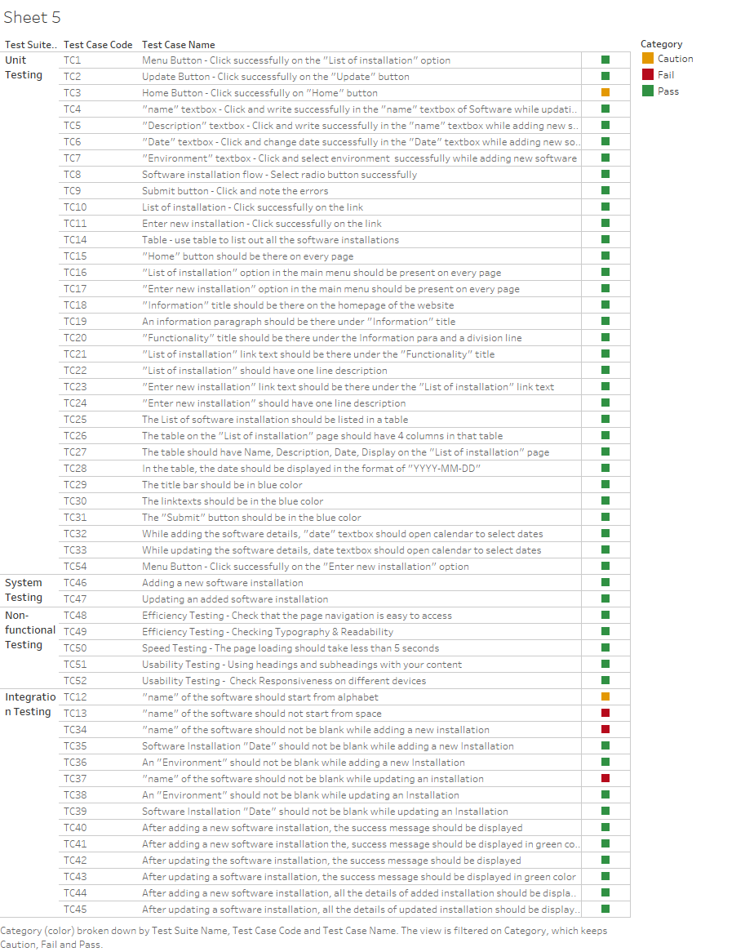

Slide 56
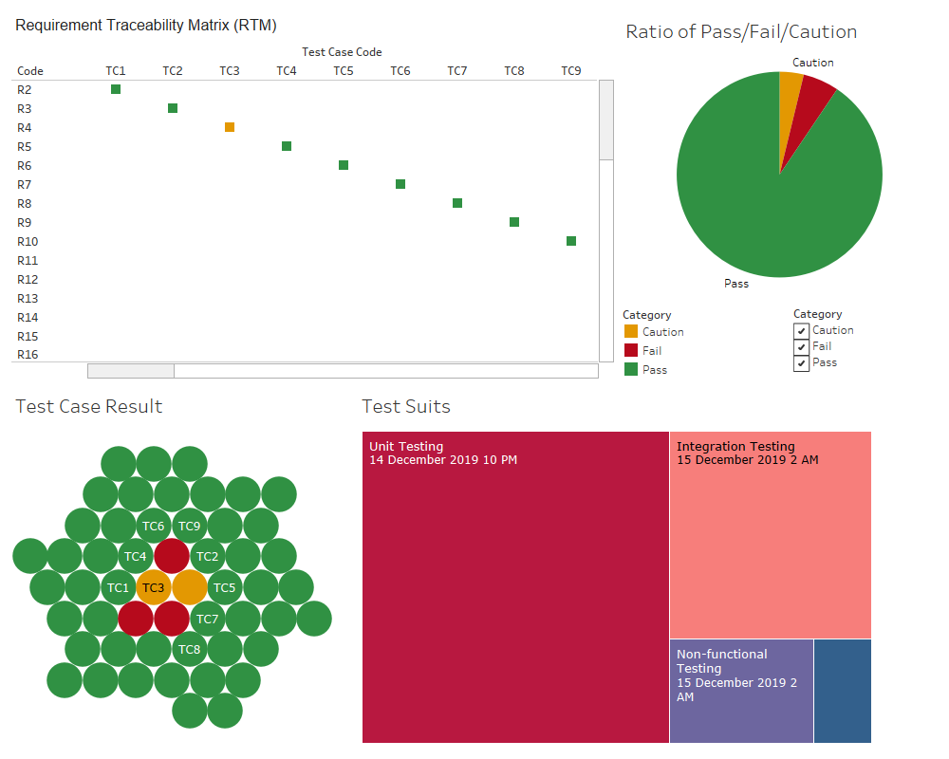

Slide 57
Thank You!
AM
Abstract Mash-up
http://abstract-mashup.matrix

